Slide 1

🌿 PAVING OPTIONS
We believe paving is more than just a surface—it’s the foundation of your outdoor space’s character and functionality. Whether you’re designing a welcoming driveway, a stylish patio, or practical garden pathways, the right paving choice transforms your landscape into a seamless blend of beauty and durability.
We offer a wide range of paving solutions tailored to suit every style and budget: from eco-friendly permeable pavers that support sustainability, to bold modern finishes that make a statement, to timeless natural stone that adds elegance. Our team ensures each option is not only visually striking but also long-lasting and suited to your lifestyle.
With expert guidance, creative design, and quality materials, we help you choose paving that enhances curb appeal, complements your landscape, and makes every step outside a pleasure.

Slide 2
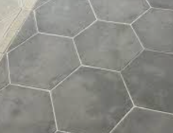
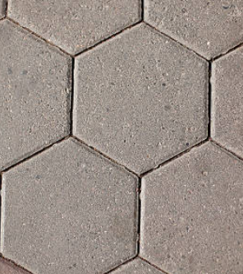
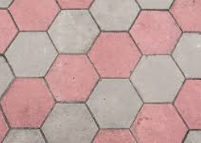
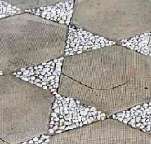
HEXAGONAL PAVERS
* These start from R8,50 per paver.

Slide 3
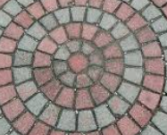
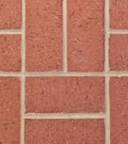
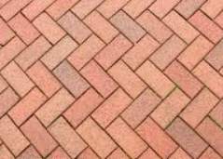
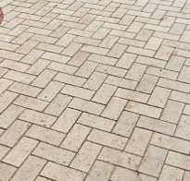
BRICK PAVERS
* These start from R3,50 per paver.

Slide 4
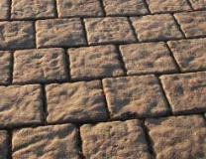
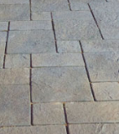
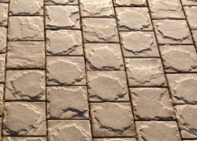
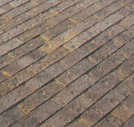
COBBLE PAVING
*These start from R250,00 a square meter.

Slide 5
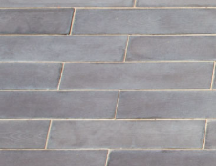
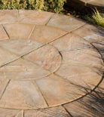
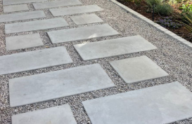
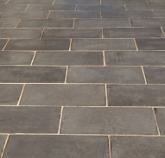
FLAG STONES
*These start from R300,00 a square meter.

Slide 6
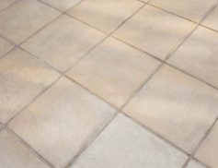
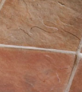
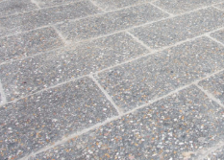
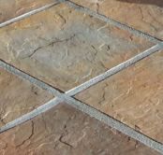
CONCRETE TILES
* These start from R350,00 a square meter,

Slide 7
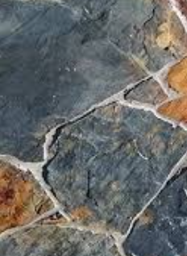
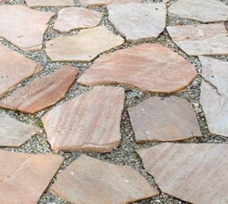
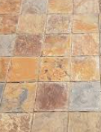

NATURAL STONE
*These start from R400,00 a square meter.

